Slide 1
Suicide Deaths in the United States
Updated August 2021

Slide 2
Suicide Rates by Sex,
United States 2010-2019
Rate (age-adjusted) per 100,000
Source: CDC, 2021
Notes:
From 2010 to 2019, the age-adjusted suicide death rate increased from 12.1 to 13.9 per 100,000 people. From 2010 to 2019, the rate increased from 19.8 to 22.4 per 100,000 for males. Among females, the rate increased from 5 in 2010 to 6 in 2019.
SOURCE: Centers for Disease Control and Prevention, National Center for Health Statistics. (2021). 1999-2019 Wide Ranging Online Data for Epidemiological Research (WONDER), Underlying Cause of Death files [Data file]. Retrieved from https://wonder.cdc.gov/Deaths-by-Underlying-Cause.html

Slide 3
Suicide and Homicide Rates, United States 2010-2019
Suicide
Rate (age-adjusted) per 100,000
Source: CDC, 2021
Notes:
Suicides consistently outnumber homicides. The homicide rate has not consistently shown the upward trend that we see with the suicide rate.
SOURCE: Centers for Disease Control and Prevention, National Center for Health Statistics. (2021). 1999-2019 Wide Ranging Online Data for Epidemiological Research (WONDER), Underlying Cause of Death files [Data file]. Retrieved from https://wonder.cdc.gov/Deaths-by-Underlying-Cause.html

Slide 4
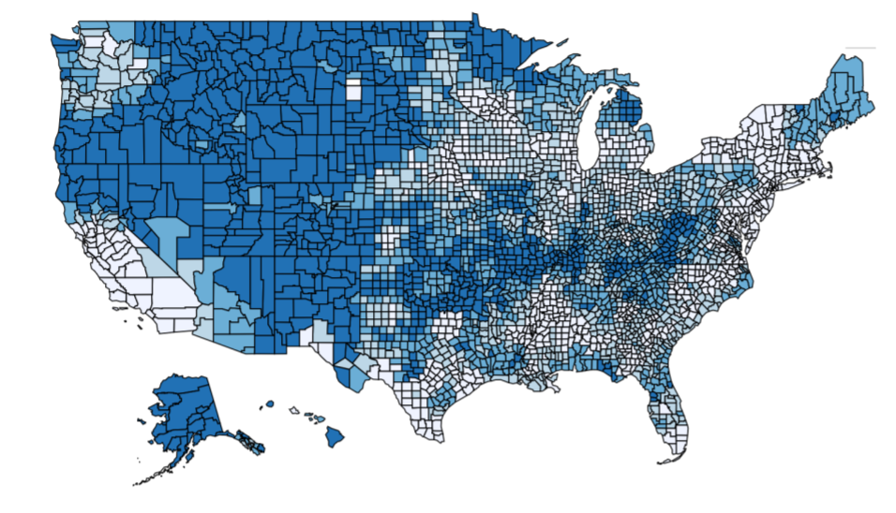
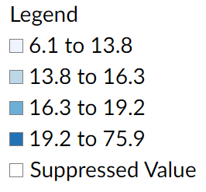
Suicide Rates at the County Level,
United States 2013-2019
Rates (age-adjusted) per 100,000
Rates appearing in this map have been geospatially smoothed
Source: CDC WISQARS, 2021
Notes:
Suicide rates are generally highest in Alaska and in the western and northwestern United States, with the exception of southern California and parts of Washington. Rural counties generally have higher rates of suicide than urban counties (Rosen et al., 2018).
SOURCE: Centers for Disease Control and Prevention. 2013-2019, United States Smoothed Age-Adjusted Death Rates per 100,000 Population [map]. All Injury, Suicide, All Races, All Ethnicities, Both Sexes, All Ages. (January 2020). Retrieved from https://www.cdc.gov/injury/wisqars/index.html
Rosen, L. M., Hedegaard, H., Kahn, D., & Warner, M. (2018). County-level trends in suicide rates in the U.S., 2005–2015. American Journal of Preventive Medicine, 55(1), 72-79.

Slide 5
Suicide by Age

Slide 6
Suicide Rates by Age, United States 2010-2019
15-24 years
Source: CDC, 2021
Notes:
Between 2009 and 2018, suicide rates increased among all age groups. In recent years, suicide rates among adults between the ages of 25 and 44 have surpassed the suicide rates of older adults (65+).
SOURCE: Centers for Disease Control and Prevention, National Center for Health Statistics. (2021). 1999-2019 Wide Ranging Online Data for Epidemiological Research (WONDER), Multiple Cause of Death files [Data file]. Retrieved from http://wonder.cdc.gov/ucd-icd10.html

Slide 7
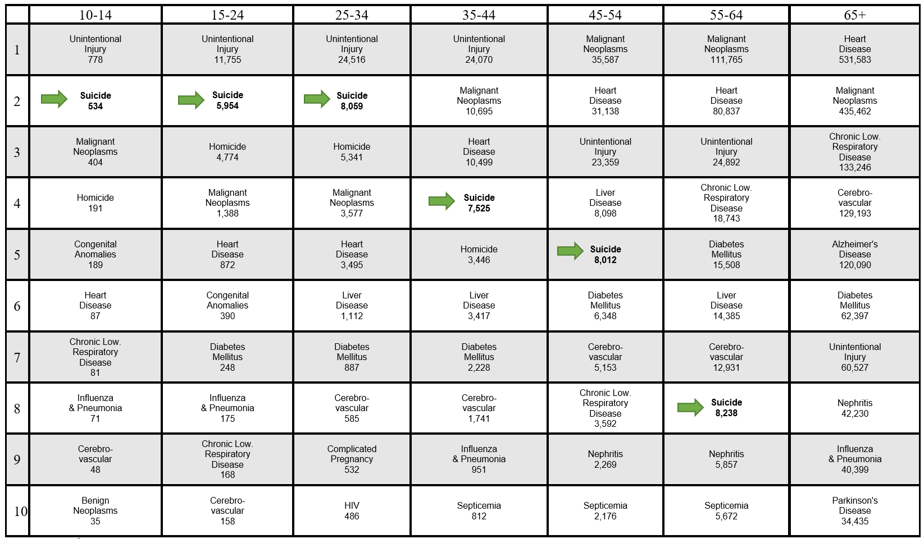
10 Leading Causes of Death by Age,
United States 2019
Age Groups
Ranking
Source: CDC, 2021
Notes:
In 2019, suicide was the second leading cause of death for youth and young adults (ages 10-34).
SOURCE: Centers for Disease Control and Prevention, National Center for Injury Prevention and Control. Web-based Injury Statistics Query and Reporting System (WISQARS) [online]. (May 2021). Retrieved from www.cdc.gov/injury/wisqars

Slide 8
Suicidal Thoughts and Suicide Attempts

Slide 9
Suicidal Behavior, United States 2019
text
1
1
47,478 Suicide Deaths (includes adults and youth)
1,379,000 Reported Suicide Attempts* (18+)
3,455,000 made any suicide plans in past year* (18+)
11,951,000 Had serious thoughts of suicide in past year* (18+)
*Self-Report
Source: CDC, 2021; SAMHSA, 2020
Notes:
Of this population, many more have serious thoughts about suicide, but many less actually make any suicide plans. Fewer report suicide attempts and fewer die by suicide.
SOURCES: Center for Behavioral Health Statistics and Quality. (2020). 2019 National Survey on Drug Use and Health: Detailed Tables. Substance Abuse and Mental Health Services Administration, Rockville, MD.
Centers for Disease Control and Prevention, National Center for Health Statistics. (2021). 1999-2019 Wide Ranging Online Data for Epidemiological Research (WONDER), Multiple Cause of Death files [Data file]. Retrieved from http://wonder.cdc.gov/ucd-icd10.html

Slide 10
Past-Year Suicidal Thoughts, Plans, and Attempts among Adults (18+) by Age, United States 2019
Percentage
Source: SAMHSA, 2019
Notes:
Across all age groups, a greater percentage of adults think about suicide than make a plan or attempt.
SOURCE: Center for Behavioral Health Statistics and Quality. (2019). 2019 National Survey on Drug Use and Health: Detailed Tables. Substance Abuse and Mental Health Services Administration, Rockville, MD. https://www.samhsa.gov/data/sites/default/files/reports/rpt29393/2019NSDUHFFRPDFWHTML/2019NSDUHFFR1PDFW090120.pdf

Slide 11
Past-Year Suicidal Thoughts, Plans and Attempts among Adults (18+) by Sex, United States 2019
Percentage
Source: SAMHSA, 2020
Notes:
Women are at greater risk for suicidal ideation, attempts, and medically treated attempts than men. However, men die by suicide at a higher rate than women.
SOURCE: Center for Behavioral Health Statistics and Quality. (2020). 2019 National Survey on Drug Use and Health: Detailed Tables. Substance Abuse and Mental Health Services Administration, Rockville, MD.

Slide 12
Past-Year Suicidal Thoughts, Plans and Attempts among High School Youth by Sex, United States 2019
Percentage
Source: CDC, 2021
Notes:
The percentage of female high school students who either considered or planned suicide is much higher than male high school students. Thoughts and attempts among high school students are higher than among adults in general.
SOURCE: Centers for Disease Control and Prevention (CDC), Youth Risk Behavior Surveillance System. (2021). 1991-2019 High School Youth Risk Behavior Survey Data [Data file]. Retrieved from http://nccd.cdc.gov/youthonline/

Slide 13
Means of Suicide

Slide 14
Means of Suicide,
United States 2019
Cut/Pierce 1.9%
Source: CDC, 2021
Notes:
Firearms are the most common means of suicide in the United States, followed by suffocation and poisoning.
SOURCE: Centers for Disease Control and Prevention, National Center for Injury Prevention and Control. (2021). Web-based Injury Statistics Query and Reporting System (WISQARS) [online]. Retrieved from www.cdc.gov/injury/wisqars

Slide 15
Means of Suicide among Males,
United States 2019
Fall 2.30%
Cut/Pierce 2.10%
Other 1.40%
Source: CDC, 2021
Notes:
Firearms are used in over half of all suicides among males.
SOURCE: Centers for Disease Control and Prevention, National Center for Injury Prevention and Control. (2021). Web-based Injury Statistics Query and Reporting System (WISQARS) [online]. Retrieved from www.cdc.gov/injury/wisqars

Slide 16
Means of Suicide among Females,
United States 2019
Source: CDC, 2021
Notes:
In 2019, firearms were the most common means of suicide for women.
SOURCE: Centers for Disease Control and Prevention, National Center for Injury Prevention and Control. (2021). Web-based Injury Statistics Query and Reporting System (WISQARS) [online]. Retrieved from www.cdc.gov/injury/wisqars

Slide 17
Means of Suicide among Males by Age, United States 2019
Source: CDC, 2021
Notes:
Firearms remain a consistent means of suicide for men over time. For men over the age of 65, firearms are used in over three-quarters of suicide deaths.
SOURCE: Centers for Disease Control and Prevention, National Center for Injury Prevention and Control. (2021). Web-based Injury Statistics Query and Reporting System (WISQARS) [online]. Retrieved from www.cdc.gov/injury/wisqars

Slide 18
Means of Suicide among Females by Age, United States 2019
Source: CDC, 2021
Notes:
The means used in suicide for women change as they age. While younger women are most likely to die by suffocation, poisoning becomes a more common means of suicide as women age.
SOURCE: Centers for Disease Control and Prevention, National Center for Injury Prevention and Control. (2021). Web-based Injury Statistics Query and Reporting System (WISQARS) [online]. Retrieved from www.cdc.gov/injury/wisqars

Slide 19
Racial and Ethnic Disparities

Slide 20
Rate of Suicide by Race/Ethnicity, United States 2010-2019
Rate (age-adjusted) per 100,000
Source: CDC, 2021
Notes:
Since 2010, the age-adjusted suicide death rate has increased for all races and ethnicities. For American Indian and Alaska Native populations, the age-adjusted suicide death rate increased from 16.9 per 100,000 in 2010 to 22.2 per 100,000 in 2019.
SOURCE: Centers for Disease Control and Prevention, National Center for Health Statistics. (2021). 1999-2019 Wide Ranging Online Data for Epidemiological Research (WONDER), Multiple Cause of Death files [Data file]. Retrieved from http://wonder.cdc.gov/ucd-icd10.html

Slide 21
Past-Year Suicidal Thoughts and Suicide Attempts for Adults, United States 2019
Percentages
*AI/AN = American Indian/Alaska Native
**NHOPI = Native Hawaiian or Pacific Islander
Source: SAMHSA, 2020
Notes:
American Indian/Alaska Native adults are at highest risk for past-year suicide-related thoughts, followed by Hispanic and White adults equally. For past-year suicide attempts, Black adults are at the highest risk, followed by Hispanic then White and AI/AN adults equally.
SOURCE: Center for Behavioral Health Statistics and Quality. (2020). 2019 National Survey on Drug Use and Health: Detailed Tables. Substance Abuse and Mental Health Services Administration, Rockville, MD.

Slide 22
Past-Year Suicidal Thoughts and Behaviors for High School Youth, United States 2019
Percentages
*Percentage estimates for AI/AN youth who had a past-year suicide attempt resulted in an injury, poisoning, or overdose that had to be treated by a doctor or nurse were too small to be reliable and are not included in this chart.
Source: CDC, 2020
Notes:
Suicidal thoughts and behaviors vary by race and ethnicity among youth. AI/AN, Multiple Race, and Asian high school youth have the highest percentages of seriously considering attempting suicide. AI/AN and Multiple Race youth had the highest percentages of making a suicide plan. By far, AI/AN had the highest percentage of attempting suicide.
SOURCE: Centers for Disease Control and Prevention (CDC), Youth Risk Behavior Surveillance System. (2021). 1991-2019 High School Youth Risk Behavior Survey Data [Data file]. Retrieved from http://nccd.cdc.gov/youthonline/

Slide 23
Racial and Ethnic Disparities:
American Indian and Alaska Native Populations

Slide 24
Suicide Rates for AI/AN Populations,
United States 2010-2019
Rate (age-adjusted) per 100,000
*Non-Hispanic
Source: CDC, 2021
Notes:
At 22.2 per 100,000, the suicide rate for AI/AN populations in 2019 was higher than the overall U.S. suicide rate of 13.2 per 100,000.
SOURCE: Centers for Disease Control and Prevention, National Center for Health Statistics. (2021). 1999-2019 Wide Ranging Online Data for Epidemiological Research (WONDER), Multiple Cause of Death files [Data file]. Retrieved from http://wonder.cdc.gov/ucd-icd10.html

Slide 25
Suicide Rates for AI/AN Populations by Age,
United States 2010-2019
Rates per 100,000
*Non-Hispanic
Source: CDC, 2021
Notes:
Among AI/AN populations, suicide rates peak during adolescence and young adulthood, and then decline. This is a different pattern than is seen in the overall U.S. population, where suicide rates peak in midlife.
SOURCE: Centers for Disease Control and Prevention, National Center for Health Statistics. (2021). 1999-2019 Wide Ranging Online Data for Epidemiological Research (WONDER), Multiple Cause of Death files [Data file]. Retrieved from http://wonder.cdc.gov/ucd-icd10.html

Slide 26
Suicide Rates for AI/AN Populations by Sex,
United States 2010-2019
*Non-Hispanic
Source: CDC, 2021
Notes:
As in the overall U.S. population, the suicide death rate for men is more than three times the rate for women in AI/AN populations. The suicide death rate for AI/AN populations is higher than that of the overall U.S. population for both males and females.
SOURCE: Centers for Disease Control and Prevention, National Center for Health Statistics. (2021). 1999-2019 Wide Ranging Online Data for Epidemiological Research (WONDER), Multiple Cause of Death files [Data file]. Retrieved from http://wonder.cdc.gov/ucd-icd10.html

Slide 27
Past-Year Suicidal Thoughts and Behaviors for Adults in AI/AN Populations, United States 2019
Percentages
*Non-Hispanic
Source: SAMHSA, 2020
Notes:
Compared to the overall U.S. population, a slightly greater percentage of AI/AN adults reported past-year serious thoughts of suicide, but not a past-year suicide plan, or a past-year suicide attempt.
SOURCE: Center for Behavioral Health Statistics and Quality. (2020). 2019 National Survey on Drug Use and Health: Detailed Tables. Substance Abuse and Mental Health Services Administration, Rockville, MD. https://www.samhsa.gov/data/sites/default/files/reports/rpt29394/NSDUHDetailedTabs2019/NSDUHDetTabsSect8pe2019.htm

Slide 28
Past-Year Suicidal Thoughts and Behaviors for High School Youth in AI/AN Populations, United States 2019
*Non-Hispanic
Source: CDC, 2019
Notes:
A higher percentage of AI/AN youth seriously considered suicide (34%) in the past year when compared to the overall U.S. (18%) population. Among high school youth, the percentage of AI/AN youth who made a suicide plan in the past year is approximately 9% higher than the percentage in the overall U.S. population.
Source: Centers for Disease Control and Prevention (CDC), Youth Risk Behavior Surveillance System. (2019). 1991-2019 High School Youth Risk Behavior Survey Data [Data file]. Retrieved from http://nccd.cdc.gov/youthonline/

Slide 29
Racial and Ethnic Disparities:
Asian, Native Hawaiian, and Other Pacific Islander Populations

Slide 30
Suicide Rates for Asian or Pacific Islander Populations, United States 2010-2019
Rate (age-adjusted) per 100,000
*Non-Hispanic
Source: CDC, 2021
Notes:
At 7.1 per 100,000, the age-adjusted suicide rate for Asian or Pacific Islander populations in 2019 was just under half the overall U.S. suicide rate of 13.2 per 100,000.
SOURCE: Centers for Disease Control and Prevention, National Center for Health Statistics. (2021). 1999-2019 Wide Ranging Online Data for Epidemiological Research (WONDER), Multiple Cause of Death files [Data file]. Retrieved from http://wonder.cdc.gov/ucd-icd10.html

Slide 31
Suicide Rates for Asian or Pacific Islander Populations by Age, United States 2010-2019
Rates per 100,000
*Non-Hispanic
Source: CDC, 2021
Notes:
In Asian or Pacific Islander populations, suicide rates peak later in life (85+). This is a different pattern than is seen in the overall U.S. population, where suicide rates peak in midlife.
SOURCE: Centers for Disease Control and Prevention, National Center for Health Statistics. (2021). 1999-2019 Wide Ranging Online Data for Epidemiological Research (WONDER), Multiple Cause of Death files [Data file]. Retrieved from http://wonder.cdc.gov/ucd-icd10.html

Slide 32
Suicide Rates for Asian or Pacific Islander Populations by Sex, United States 2010-2019
*Non-Hispanic
Source: CDC, 2021
Notes:
In Asian or Pacific Islander populations, the suicide death rate for men is more than double the rate for women. Among males, the suicide death rate for the overall U.S. population is more than double that of Asian or Pacific Islander populations.
SOURCE: Centers for Disease Control and Prevention, National Center for Health Statistics. (2021). 1999-2019 Wide Ranging Online Data for Epidemiological Research (WONDER), Multiple Cause of Death files [Data file]. Retrieved from http://wonder.cdc.gov/ucd-icd10.html

Slide 33
Past-Year Suicidal Thoughts and Behaviors for Adults in Asian and Native Hawaiian/Other Pacific Islander Populations, 2019
Percentage
*Non-Hispanic
Source: SAMHSA, 2020
Notes:
When compared to the overall U.S. population, a lower percentage of Asian and Native Hawaiian or Other Pacific Islander adults report past-year serious thoughts of suicide, a past-year suicide plan, or a past-year suicide attempt.
SOURCE: Center for Behavioral Health Statistics and Quality. (2020). 2019 National Survey on Drug Use and Health: Detailed Tables. Substance Abuse and Mental Health Services Administration, Rockville, MD. https://www.samhsa.gov/data/report/2018-nsduh-detailed-tables

Slide 34
Past-Year Suicidal Thoughts and Behaviors for High School Youth in Asian Populations, 2019
*Non-Hispanic
**Percentage estimates for Native Hawaiian/Pacific Islander youth were not available and are not included in this chart.
Source: CDC, 2021
Notes:
Among high school youth, there are similar percentages for seriously considering attempting suicide or making a suicide plan in the past year than in the overall U.S. population. Percentages of past-year attempted suicides and suicide attempt requiring treatment are slightly lower for Asian youth than for the overall U.S. population.
Source: Centers for Disease Control and Prevention (CDC), Youth Risk Behavior Surveillance System. (2021). 1991-2019 High School Youth Risk Behavior Survey Data [Data file]. Retrieved from http://nccd.cdc.gov/youthonline/

Slide 35
Racial and Ethnic Disparities:
Black Populations

Slide 36
Suicide Rates for Black Populations,
United States 2010-2019
Overall U.S.
Rate (age-adjusted) per 100,000
Black
*Non-Hispanic
Source: CDC, 2021
Notes:
At 7.4 per 100,000, the age-adjusted suicide rate for Black populations in 2019 was over half the overall U.S. suicide rate of 13.2 per 100,000.
SOURCE: Centers for Disease Control and Prevention, National Center for Health Statistics. (2020). 1999-2019 Wide Ranging Online Data for Epidemiological Research (WONDER), Multiple Cause of Death files [Data file]. Retrieved from http://wonder.cdc.gov/ucd-icd10.html

Slide 37
Suicide Rates for Black Populations by Age,
United States 2010-2019
Rates per 100,000
*Non-Hispanic
Source: CDC, 2021
Notes:
Among Black populations, suicide rates peak during adolescence and young adulthood, then decline. This is a different pattern than is seen in the overall U.S. population, where suicide rates peak in midlife.
SOURCE: Centers for Disease Control and Prevention, National Center for Health Statistics. (2021). 1999-2019 Wide Ranging Online Data for Epidemiological Research (WONDER), Multiple Cause of Death files [Data file]. Retrieved from http://wonder.cdc.gov/ucd-icd10.html

Slide 38
Suicide Death Rates for Black Populations by Sex,
United States 2010-2019
*Non-Hispanic
Source: CDC, 2021
Notes:
As in the overall U.S. population, the suicide death rate for men is more than four times the rate for women in Black populations. The suicide death rate for the overall U.S. population is approximately double that of Black populations for both males and females.
SOURCE: Centers for Disease Control and Prevention, National Center for Health Statistics. (2021). 1999-2019 Wide Ranging Online Data for Epidemiological Research (WONDER), Multiple Cause of Death files [Data file]. Retrieved from http://wonder.cdc.gov/ucd-icd10.html

Slide 39
Past-Year Suicidal Thoughts and Behaviors for Adults in Black Populations, United States 2019
Percentage
*Non-Hispanic
Source: SAMHSA, 2020
Notes:
Compared to the overall U.S. population, Black adults reported less percentages of past-year serious thoughts of suicide and a past-year suicide plan. However, the percentage of past-year suicide attempt was higher in Black adult populations. than the overall U.S.
SOURCE: Center for Behavioral Health Statistics and Quality. (2020). 2019 National Survey on Drug Use and Health: Detailed Tables. Substance Abuse and Mental Health Services Administration, Rockville, MD. https://www.samhsa.gov/data/sites/default/files/reports/rpt29394/NSDUHDetailedTabs2019/NSDUHDetTabsSect8pe2019.htm

Slide 40
Past-Year Suicidal Thoughts and Behaviors for High School Youth in Black Populations, United States 2019
*Non-Hispanic
Source: CDC, 2021
Notes:
Among high school youth, a smaller percentage of Black youth report seriously considering attempting suicide or making a suicide plan in the past year than the overall U.S. population. However, a higher percentage of Black youth have attempted suicide in the past year. Black youth attempting suicide that required treatment is about equal to the overall U.S. population.
Source: Centers for Disease Control and Prevention (CDC), Youth Risk Behavior Surveillance System. (2021). 1991-2019 High School Youth Risk Behavior Survey Data [Data file]. Retrieved from http://nccd.cdc.gov/youthonline/

Slide 41
Racial and Ethnic Disparities:
Hispanic Populations

Slide 42
Suicide Rates for Hispanic Populations,
United States 2010-2019
Overall U.S.
Rate (age-adjusted) per 100,000
Hispanic
Source: CDC, 2020
Notes:
At 7.3 per 100,000, the age-adjusted suicide rate for Hispanic populations in 2019 was just over half the overall U.S. suicide rate of 13.2 per 100,000 in 2019.
SOURCE: Centers for Disease Control and Prevention, National Center for Health Statistics. (2020). 1999-2018 Wide Ranging Online Data for Epidemiological Research (WONDER), Multiple Cause of Death files [Data file]. Retrieved from http://wonder.cdc.gov/ucd-icd10.html

Slide 43
Suicide Rates for Hispanic Populations by Age,
United States 2010-2019
Source: CDC, 2021
Notes:
Among Hispanic populations, suicide rates remain somewhat steady across the lifespan. This is a different pattern than is seen in the overall U.S. population, where suicide rates peak in midlife.
SOURCE: Centers for Disease Control and Prevention, National Center for Health Statistics. (2021). 1999-2019 Wide Ranging Online Data for Epidemiological Research (WONDER), Multiple Cause of Death files [Data file]. Retrieved from http://wonder.cdc.gov/ucd-icd10.html

Slide 44
Suicide Death Rates for Hispanic Populations by Sex, United States 2010-2019
Source: CDC, 2021
Notes:
As in the overall U.S. population, the suicide death rate for men is more than three times the rate for women in Hispanic populations. The suicide death rate for the overall U.S. population is more than double that of non-Hispanic populations for both males and females.
SOURCE: Centers for Disease Control and Prevention, National Center for Health Statistics. (2021). 1999-2019 Wide Ranging Online Data for Epidemiological Research (WONDER), Multiple Cause of Death files [Data file]. Retrieved from http://wonder.cdc.gov/ucd-icd10.html

Slide 45
Past-Year Suicidal Thoughts and Behaviors for Adults in Hispanic Populations, United States 2019
Percentage
Source: SAMHSA, 2020
Notes:
When Hispanic adults are compared to the overall U.S. population, similar percentages report a past-year serious thoughts of suicide, past-year suicide plan, and a past-year suicide attempt when compared to the overall U.S. population.
SOURCE: Center for Behavioral Health Statistics and Quality. (2020). 2019 National Survey on Drug Use and Health: Detailed Tables. Substance Abuse and Mental Health Services Administration, Rockville, MD. https://www.samhsa.gov/data/sites/default/files/reports/rpt29394/NSDUHDetailedTabs2019/NSDUHDetTabsSect8pe2019.htm

Slide 46
Past-Year Suicidal Thoughts and Behaviors for High School Youth in Hispanic Populations, United States 2019
Source: CDC, 2020
Notes:
Among high school youth, a smaller percentage of Hispanic youth report seriously considering attempting suicide in the past year and made a suicide plan than the overall U.S. population. The percentage of youth who attempt suicide is similar to the overall U.S. population. However, a slightly higher percentage of Hispanic youth have required treatment after attempting suicide.
Source: Centers for Disease Control and Prevention (CDC), Youth Risk Behavior Surveillance System. (2021). 1991-2019 High School Youth Risk Behavior Survey Data [Data file]. Retrieved from http://nccd.cdc.gov/youthonline/

Slide 47
Racial and Ethnic Disparities:
White Populations

Slide 48
Suicide Rates for White Populations,
United States 2010-2019
Rate (age-adjusted) per 100,000
Overall U.S.
*Non-Hispanic
Source: CDC, 2021
Notes:
At 17.5 per 100,000, the age-adjusted suicide rate for White populations in 2019 was higher than the overall U.S. suicide rate of 13.2 per 100,000.
SOURCE: Centers for Disease Control and Prevention, National Center for Health Statistics. (2021). 1999-2019 Wide Ranging Online Data for Epidemiological Research (WONDER), Multiple Cause of Death files [Data file]. Retrieved from http://wonder.cdc.gov/ucd-icd10.html

Slide 49
Suicide Rates for White Populations by Age,
United States 2010-2019
Rates per 100,000
*Non-Hispanic
Source: CDC, 2021
Notes:
The pattern of suicide death rates among White populations and the suicide death rate of the overall U.S. population is similar across the lifespan, peaking in midlife. The suicide death rate for White populations is higher than the overall U.S. population across the lifespan.
SOURCE: Centers for Disease Control and Prevention, National Center for Health Statistics. (2021). 1999-2019 Wide Ranging Online Data for Epidemiological Research (WONDER), Multiple Cause of Death files [Data file]. Retrieved from http://wonder.cdc.gov/ucd-icd10.html

Slide 50
Suicide Death Rates for White Populations by Sex,
United States 2010-2019
*Non-Hispanic
Source: CDC, 2021
Notes:
As in the overall U.S. population, the suicide death rate for men is more than three times the rate for women in White populations. The suicide death rate for White populations is higher than that of the overall U.S. population for both males and females.
SOURCE: Centers for Disease Control and Prevention, National Center for Health Statistics. (2010). 1999-2019 Wide Ranging Online Data for Epidemiological Research (WONDER), Multiple Cause of Death files [Data file]. Retrieved from http://wonder.cdc.gov/ucd-icd10.html

Slide 51
Past-Year Suicidal Thoughts and Behaviors for Adults in White Populations, United States 2019
*Non-Hispanic
Source: SAMHSA, 2021
Notes:
Compared to the overall U.S. population, similar percentages of White adults reported past-year serious thoughts of suicide, a past-year suicide plan, and a past-year suicide attempt.
SOURCE: Center for Behavioral Health Statistics and Quality. (2020). 2019 National Survey on Drug Use and Health: Detailed Tables. Substance Abuse and Mental Health Services Administration, Rockville, MD. https://www.samhsa.gov/data/sites/default/files/reports/rpt29394/NSDUHDetailedTabs2019/NSDUHDetTabsSect8pe2019.htm

Slide 52
Past-Year Suicidal Thoughts and Behaviors for High School Youth in White Populations, United States 2019
*Non-Hispanic
Source: CDC, 2021
Notes:
Among White high school youth, the percentage of those who seriously considered attempting suicide and making a suicide plan is similar to the overall U.S. population. The percentages of White youth who attempt suicide and attempt suicide requiring treatment is slightly less than the overall U.S. population.
Source: Centers for Disease Control and Prevention (CDC), Youth Risk Behavior Surveillance System. (2021). 1991-2019 High School Youth Risk Behavior Survey Data [Data file]. Retrieved from http://nccd.cdc.gov/youthonline/

Slide 53
Suicide and Opioids

Slide 54
Selected Injury-Related Death Rates,
United States 2005-2019
Rate (age-adjusted) per 100,000
Source: CDC, 2021
Notes:
This graph represents age-adjusted death rates over a 15-year period. Suicide and unintentional drug poisonings have generally seen sustained increases that are not seen in other injury-related causes of death, although in 2018, the age-adjusted rate of unintentional poisonings decreased. Motor vehicle deaths have seen a decline from 2005 and plateaued around 2014. Homicide age-adjusted rates plateaued and then decreased until 2014, when a slight increase was seen through 2018.
SOURCE: Centers for Disease Control and Prevention, National Center for Health Statistics. (2021). 1999-2019 Wide Ranging Online Data for Epidemiological Research (WONDER), Multiple Cause of Death files [Data file]. Retrieved from http://wonder.cdc.gov/ucd-icd10.html

Slide 55
Suicide Deaths by Method, United States 2019
Poisoning Suicides by Substance – 2019
Suffocation
29%
Poisoning
13%
Firearms
51%
Other
7%
Source: CDC, 2021
Notes:
This pie chart illustrates means of suicide deaths by various methods. Firearms accounted for a majority (51%) of the deaths by suicide, suffocation (29%) and other (7%). Poisonings accounted for 13% of suicide deaths in 2019. The accompanying bar graph illustrates the contribution of various substances to poisoning suicides. As the graph shows, other and unspecified drugs, medicaments and biological substances are contributors in over 45% of poisoning deaths.
SOURCE: Centers for Disease Control and Prevention, National Center for Health Statistics. (2021). 1999-2019 Wide Ranging Online Data for Epidemiological Research (WONDER), Multiple Cause of Death files [Data file]. Retrieved from http://wonder.cdc.gov/ucd-icd10.html

Slide 56
Serious Thoughts of Suicide and Pain Reliever Abuse, Adults (18+)
Percent with serious thoughts of suicide
Source: SAMHSA, 2020
Notes:
This bar graph includes adults (18+) who reported serious thoughts of suicide in the past year. When adults with past-year pain reliever abuse (including opioids) are compared with the general population, they are at higher risk for suicidal thoughts. This pattern has held true every year for the past several years.
SOURCE: Center for Behavioral Health Statistics and Quality. (2020). 2019 National Survey on Drug Use and Health: Detailed Tables. Substance Abuse and Mental Health Services Administration, Rockville, MD.

Slide 57
Suicide and Serious Mental Illness

Slide 58
Current Mental Health Status for Suicide Decedents in 36 U.S. States by Gender, 2018
Source: CDC, 2021
Notes:
This bar graph presents the current mental health status of suicide decedents in 36 U.S. states by gender. A similar percentage of male and female decedents experienced current depressed mood. When compared to male decedents, a greater percentage of female decedents was identified as having a current mental health problem. Higher current treatment for mental illness was reported for females than for males.
SOURCE: Centers for Disease Control and Prevention, National Center for Injury Prevention and Control. Web-based Injury Statistics Query and Reporting System (WISQARS) [online]. (2021). Available from URL:
https://www.cdc.gov/injury/wisqars/nvdrs.html

Slide 59
Mental Health and Suicide History of Suicide Decedents in 36 U.S. States by Gender, 2018
Source: CDC, 2021
Notes:
This bar graph presents the mental health and suicide history of suicide decedents in 36 U.S. states, by gender. When compared to male decedents, a greater percentage of female decedents had been ever treated for a mental health problem. Female decedents also had a higher history of suicidal thoughts and a higher history of suicide attempts.
SOURCE: Centers for Disease Control and Prevention, National Center for Injury Prevention and Control. Web-based Injury Statistics Query and Reporting System (WISQARS) [online]. (2021). Available from URL: https://www.cdc.gov/injury/wisqars/nvdrs.html

Slide 60
Substance Abuse and Dependence among Suicide Decedents in 36 U.S. States by Gender, 2018
Source: CDC, 2021
Notes:
This bar graph presents substance abuse and dependence among suicide decedents in 36 U.S. states by gender. When compared to female decedents, a greater percentage of male decedents were identified as having current alcohol dependence. A slightly lower percentage of male decedents were identified as having a current other substance abuse problem, when compared to female decedents.
SOURCE: Centers for Disease Control and Prevention, National Center for Injury Prevention and Control. Web-based Injury Statistics Query and Reporting System (WISQARS) [online]. (2021). Available from URL: https://www.cdc.gov/injury/wisqars/nvdrs.html

Slide 61
Suicidal Behavior and Past-Year Major Depressive Episode, United States 2019
Source: SAMHSA, 2019
Notes:
Past-year suicide-related thoughts and behaviors are much more common among those with a past-year major depressive episode. Making a suicide plan is much more common among those with a past-year major depressive episode.
SOURCE: Center for Behavioral Health Statistics and Quality. (2020). 2019 National Survey on Drug Use and Health: Detailed Tables. Substance Abuse and Mental Health Services Administration, Rockville, MD.

Slide 62
Suicidal Behavior and Past-Year Substance Use Disorder, United States 2019
Source: SAMHSA, 2020
Notes:
Individuals with a past-year substance use disorder are over four times more likely to have serious thoughts of suicide in the past year than those who do not. They are almost six times more likely to have made a suicide plan or attempted suicide in the past year.
SOURCE: Center for Behavioral Health Statistics and Quality. (2020). 2019 National Survey on Drug Use and Health: Detailed Tables. Substance Abuse and Mental Health Services Administration, Rockville, MD.

Slide 63
Suicidal Behavior and Past-Year Serious Psychological Distress, United States 2019
Source: SAMHSA, 2019
Notes:
Individuals who report past-year serious psychological distress may be at substantially elevated risk for suicide-related thoughts and behaviors.
SOURCE: Center for Behavioral Health Statistics and Quality. (2020). 2019 National Survey on Drug Use and Health: Detailed Tables. Substance Abuse and Mental Health Services Administration, Rockville, MD.

